Slide 1
KISSAN DOST
Muhammad Hamza | Mubashir Nisar

Slide 2
Problem Statement
Pakistan is a land of agriculture and farmers are its root. But the farmers don’t get the true value of their agricultural products. Farmers sometimes are forced to sell their products at low prices or sometimes they are even unable to sell the crops. Thus they are not able to do the profitable business of their crops or goods in the markets. The following project can help farmers to solve this issue and in future this project can become the right hand of the farmers.

Slide 3
Proposed Solution
KISSAN DOST app will help farmers to sell his crops directly to the retailers, by setting a base price for his crop, and many retailers bid for certain products they want from the farmers. This app uses a bidding system, for selling of crops from the farmer side to the retailer side. This helps the farmer to gain some profit, otherwise, they used to get manipulated by the middlemen.

Slide 4
Project Scope
Farmer’s Role
Customer’s Role
Administrator’s Role
Notes:
May require more than one slide

Slide 5
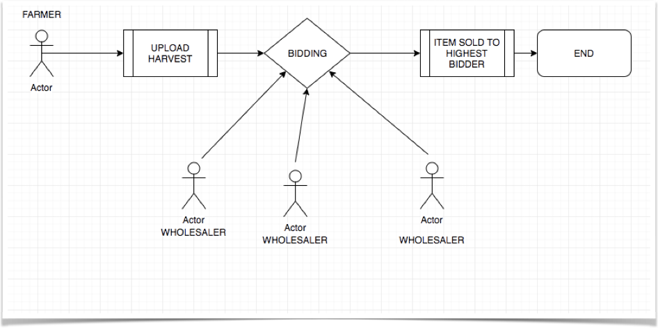
Activity Diagram

Slide 6
Objectives
The main aim of the project is to design a platform where farmers can sell their fruits and vegetables at a profitable price.
The consumers can directly buy those good produced by farmers.
By this, the in-between profit gainers are removed and farmers can get the true value of their goods.

Slide 7
Strengths
reasonable profit margin
No such system available
Biding system for costumers
Weaknesses
Less awareness among farmers about online systems

Slide 8
Opportunities
No competitors yet.
Threats
Existing online systems may start this before us.

Slide 9
Implementation
App for both (Android & IOS)
Web front end (Future Plan)
Notes:
May require more than one slide

Slide 10
Resources
iOS App Development Resources
iOS Design Guide
iOS Icon Templates
Apple iPad app Development guidelines
Optimizing iPad app for Multitasking
iPad app multitasking Developer guide
Submitting app to the Apple Store

Slide 11
Resources
Android App Development Resources
Getting Started on Android
Complete Android Developers Guide
Supporting Different Devices
App Launcher & icon guidelines
Tablet Design Optimization Guidelines
Submitting App to the Google Play Store

Slide 12
Estimated Cost
Analytics and user experience - 20,000
Design - 50,000
Front-end - 20,000
Back-end - 20,500
Marketing- 20,000
QA - 60,500
Grand total: 200,000. In essence, that’s the cost price. But you’ve got to consider risks, taxes, rent, and interest. Then we get an approximate budget of 220,000, for which our company can aim a stellar project without bugs or delays for release in Apple Store or Google Play.

Slide 13
Revenue Policies
Google Ads Banners
Google Video Ads
Freemium App Model
App/SMS/Email Marketing

Slide 14
Marketing
Sponsoring on fb, Instagram and youtube.
Visiting different villages
We can approach Punjab Agriculture Department

Slide 15
OTHER APPS IN THE MARKET
Mandi App (Leaning toward Wholesalers)
Mandi Trades (Only Buying and Selling)

Slide 16
How are we different?
We provide one of the revolutionary - a bidding feature that will make the wholesalers fight in competition towards farmers advantage
Everything is real time and hence there is no necessity go the go downs for the farmer to store his produce as his harvest will be sold in real time
The exact location of the farmer is recorded by our map interface and this can be used for the future survey and to track farmers activity by the government

Slide 17
Any Question?

Slide 18
References
https://medium.com/appdexa/4-ways-to-actively-generate-revenue-from-mobile-apps-e39d7cc7faca
https://intelligentbee.com/2019/03/04/generate-revenue-from-mobile-app/
https://codeburst.io/so-you-want-to-build-an-app-heres-how-to-budget-91207ca098e8
https://blog.appvirality.com/plan-mobile-app-budget-6-easy-steps/

